Slide 1
www.BerkeleyPrize.org

Slide 2
The International
BERKELEY UNDERGRADUATE
PRIZE FOR ARCHITECTURAL
DESIGN EXCELLENCE
1997 - 2014

Slide 3
FOUNDED BY:
RAYMOND LIFCHEZ
Professor of Architecture and City & Regional Planning
University of California, Berkeley
U.S.A.
DEDICATED TO HIS WIFE:
Judith Lee Stronach May 25, 1943 - November 29, 2002 Poet, Journalist, Teacher, Philanthropist

Slide 4
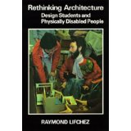

Slide 5
COORDINATOR AND WEBSITE EDITOR:
Benjamin Clavan, Ph.D., AIA
TEAM MEMBERS:
Thea Chroman, Administrator
Jessie Canon, Internet Technology

Slide 6
BERKELEY PRIZE COMMITTEE
64 Current Members
Educators
Design Professionals
Allied Professionals
Social Scientists

Slide 7
PURPOSE OF THE BERKELEY PRIZE
To promote the investigation and teaching of the
Social Art of Architecture…
At the heart of which is the shift from object-centered to
people-centered design.

Slide 9
Universal design =
Inclusive Design =
Design for People =
The Social Art of Architecture

Slide 10
STUDENT COMPETITIONS
Essay Prize
1997 - 2014
Travel Fellowships
2004 - 2014
Student-run Architectural Design
2008 - 2012

Slide 11
Number of Student Participants
1870
Countries Represented
62
Prizes Awarded
106 – Students
8 - Faculty

Slide 12
YEARLY THEMES
THE ARCHITECT MEETS THE NURSING HOME
VALUING THE SACRED
SUSTAINABLE ARCHITECTURE/TRADITIONAL WISDOM
THE ARCHITECT CONFRONTS POVERTY
……
2014
THE ARCHITECT AND THE ACCESSIBLE CITY

Slide 13
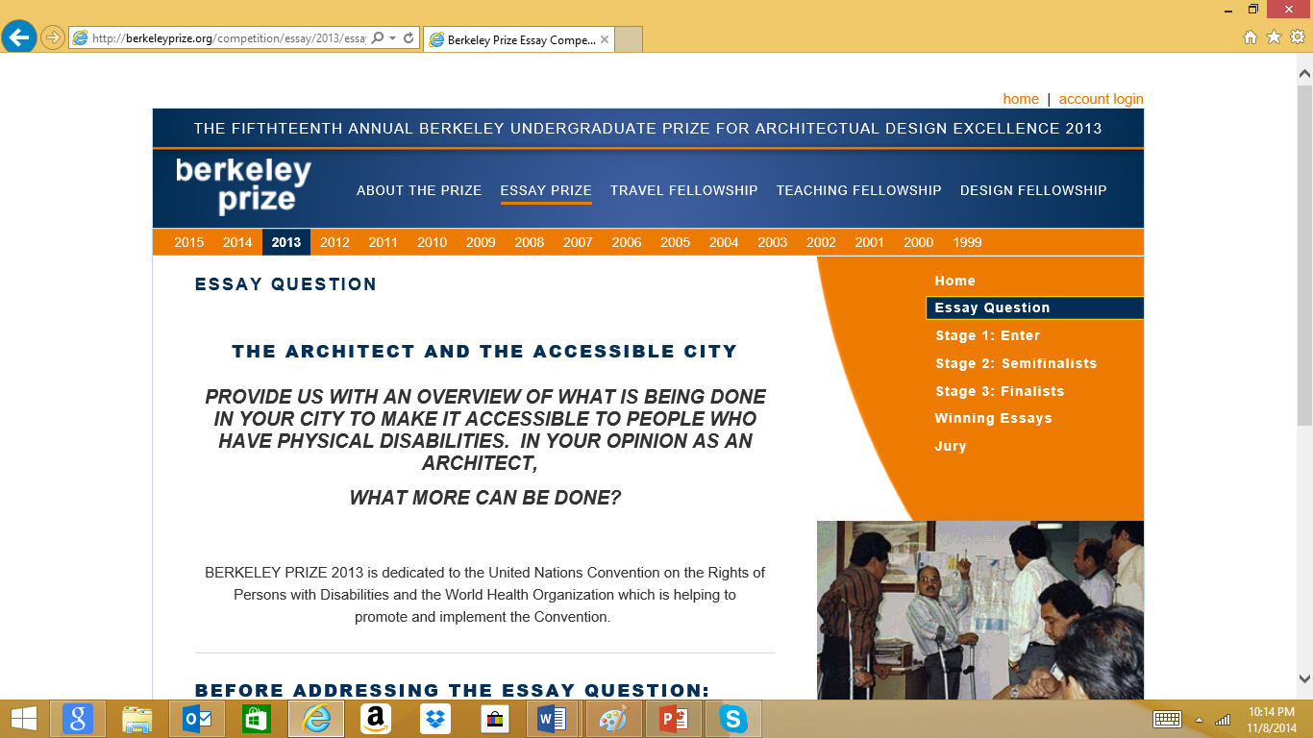

Slide 14
FACULTY COMPETITIONS
Teaching Fellowships
2013-2014
2013
TEACHING THE SOCIAL ART OF ARCHITECTURE: UNIVERSAL DESIGN

Slide 15
Dedicated to and Coordinated by
MS. ELAINE OSTROFF, HONORARY AIA
Co-founder of Adaptive Environments
(now, Institute for Human Centered Design – IHCD)
Creator of the term “User/expert”

Slide 16
FIVE TEACHING FELLOWSHIPS WERE
AWARDED
ONE ASSOCIATE TEACHING FELLOWSHIP
WAS AWARDED

Slide 17
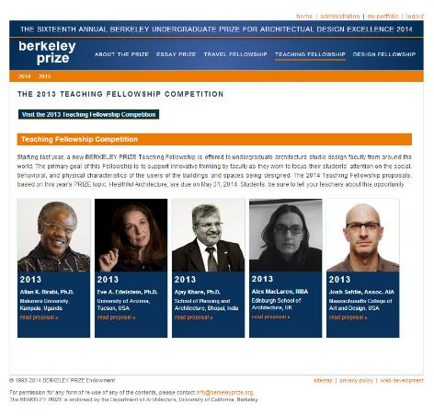

Slide 18
Mr. Allan K. Birabi, Ph.D.
Senior Lecturer
MAKERERE UNIVERSITY
Department of Architecture and Physical Planning
Kampala, Uganda

Slide 19
Ms. Eve A. Edelstein, Ph.D., Associate AIA
Associate Professor
UNIVERSITY OF ARIZONA
College of Architecture, Planning and Landscape
Tucson, Arizona, USA
(Now, at the NewSchool of Architecture
And Design, San Diego, California, U.S.A

Slide 20
Mr. Ajay Khare, Ph.D.
Founder-Director
SCHOOL OF PLANNING AND
ARCHITECTURE
Bhopal, India

Slide 21
Ms. Alex MacLaren
Design Tutor
EDINBURGH SCHOOL OF ARCHITECTURE
AND LANDSCAPE ARCHITECTURE
(ESALA)
Edinburgh, Scotland
United Kingdom

Slide 22
Mr. Josh Safdie, Associate AIA
Adjunct Faculty Member
MASSACHUSETTS COLLEGE OF ART AND DESIGN (MassArt)
Boston, Massachusetts
U.S.A.

Slide 23
Mr. Faiq Mari
Teaching and Research Assistant
Department of Architecture
Faculty of Engineering
BIRZEIT UNIVERSITY
Palestine

Slide 24
AREAS OF AGREEMENT
(Not Just) Accessibility
(Not Just) Universal Design
(Not Just) Inclusive Design
Human-Centered Architecture

Slide 25
Mr. Allan K. Birabi, Ph.D.
Summary presented by Benjamin Clavan
Full paper available in the Proceedings

Slide 26
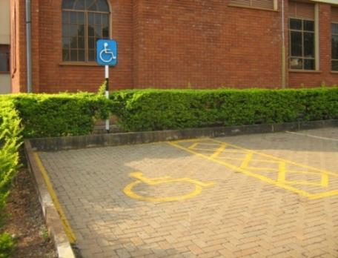

Slide 27
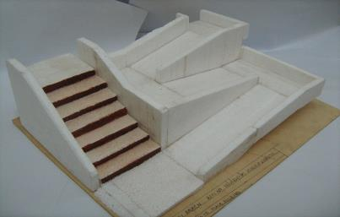

Slide 28
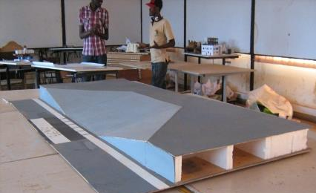

Slide 29
Ms. Eve Edelstein, Ph.D.
Summary presented by Benjamin Clavan
Full paper available in the Proceedings

Slide 30
Neuro-Universal Design
Eve A. Edelstein
M.Arch., Ph.D. (neurosci), F-AAA
neuroarchitecture@gmail.com

Slide 31
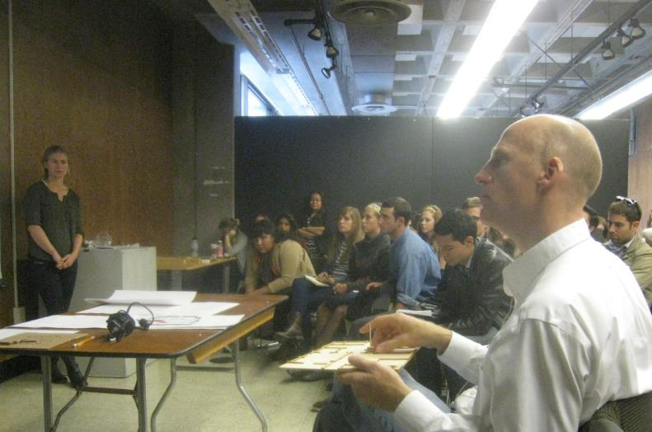
Acknowledgements
~200 Students B.Arch + M.Arch
5 Disability & Rehab Faculty
5 Universities: UCB, UA, NSAD, SDSU
1 Neuro-Architecture Faculty
6 Design Faculty

Slide 32
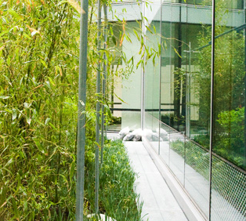
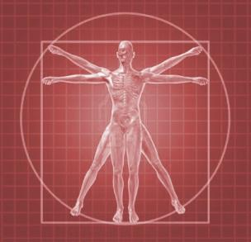
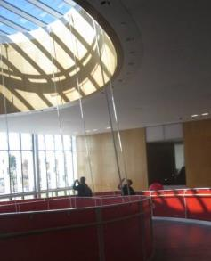
Input Response Outcome
Environment Brain Universal
& Context & Body Design
Approach: Neuro-Universal Design
Notes:
The Neuro-Universal approach is a simple conceptual framework based on the scientific method (input-response-output) gave students a step-by-step guide to think about how 1) each and every element or attribute of built space might influence the 2) brain, mind, body or behavior and 3) support universal design objectives.

Slide 33
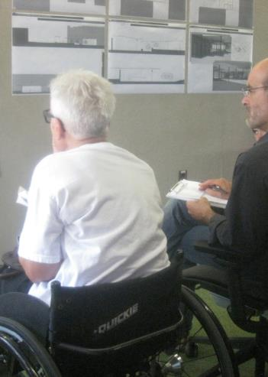
Challenge: Faculty Take on More
We already teach accessible design.
“We don’t have time to teach about human responses.”
“Just give us a list of the brain’s response to design.”
“Limit your lecture to 1 hour.”
©Edelstein 2014
Notes:
Design faculty were challenged to fit this new content into their densely packed curricula. It took some time for faculty to realize that peer-to-peer faculty interactions with multiple user/experts from many disciplines offer a vast range of expertise and new perspectives about the many uses of a space.
Students were encouraged to think about both universal ‘uses’ and the diversity of ‘users’ that will interact with their design.

Slide 34
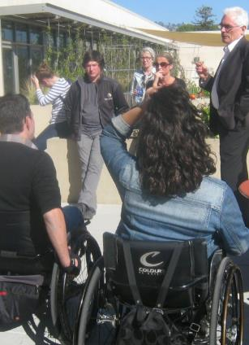
Essential : peer-peer user/expert interaction
Peer-to-peer learning with
user/experts in all teams:
faculty, professionals & students.
Repeated conversations &
real-world interactions
in studio and on-site.

Slide 35
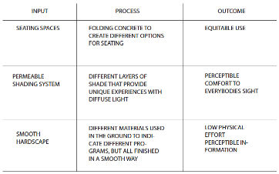
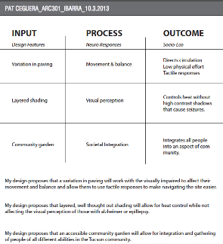
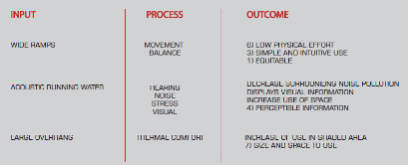
Student Work: Design Inquiry Framework
Notes:
For each project, students were asked to create a design hypothesis and then to use available research to populate a decision grid that linked built attributes and human responses to the 7 universal design objectives for all user types.
This aided their design thinking and inquiry into many competing needs.

Slide 36
Results: Integrated Thinking
Notes:
The Design hypothesis then drives exploration of design solutions with evaluation of which solution meets the most universal objectives

Slide 37
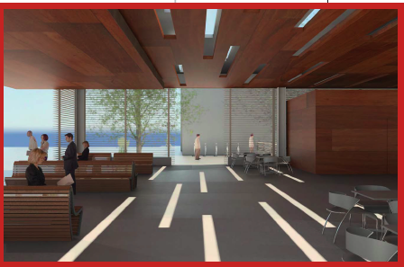
Results: Student Work
Notes:
Urban transportation center uses wood to control acoustics, light to create wayfinding paths, smooth floor materials to minimize tripping hazards, and wide linear pathways for easy circulation.

Slide 38
Follow-up Survey: Students
90% strongly agreed or agreed
“These experiences made me think about designing for people with a broad range of abilities.
80% strongly agreed or agreed
“These experiences influenced the design of my studio projects.”
90% strongly agreed or agreed
“These experiences will influence how I design in the future.”

Slide 39
Follow-up Survey: Faculty
“Involving user/experts is invaluable.”
“…this content is not just an add-on”.
“…needs commitment beyond the superficial...”
©Edelstein 2014

Slide 40
Outcome: Change
Professional adoption of a
‘neuro-universal’ approach must
change the ‘design process’
rather than ‘persuading individuals’ to change.
“… it is not people who change,
but the innovations themselves.”
(Robinson, 2009)
Notes:
For example, ATHENE project in London - Assistive Technologies for Healthy Living in Elders: Needs Assessment by Ethnography
– considering incentives and disincentives to use, looking at factors that facilitated or presented barriers to using it – discovered the ongoing work that was needed to support it, both on an individual and organizational level.
It was more than presenting new ides themselves; rather, they needed to figure out how to make it fit with the individuals’ lifestyle & social networks- and also how the organization would support the implementation and ongoing support and procedures to keep the process going.
In this context – need to consider design strategies, individual adopters (people with and without disabilities), the process of social influence, the innovativeness and readiness of organizations to implement these strategies and make them a routine part of the curriculum & instruction.

Slide 41
Impact
“I can assure you
that you have had a great impact
on the way the students think.”
Berkeley Prize student
& wheelchair user

Slide 42
Thank you.
Neuro-Universal Design
Eve Edelstein
Please accept my
apologies for not
being able to join you
in person at this
important conference.

Slide 43
Mr. Ajay Khare, Ph.D. with
Ms. Rachna Khare
Summary presented by
Mr. Sushil Kumar Solanki, Architect
Assistant Professor and Member of
the Teaching Fellowship faculty at the School of Planning and Architecture, Bhopal
Full paper available in the Proceedings

Slide 44
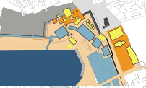
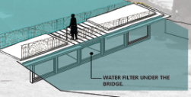
“GLOCALIZING UNIVERSAL DESIGN EDUCATION FOR CULTURAL INTERFACE IN INDIA”
Dr. Ajay Khare, Dr. Rachna Khare, Sushil Kumar Solanki, Architect
School of Planning and Architecture, Bhopal, India
(S.P.A, Bhopal)

Slide 45
India :
Seventh largest country in world by area.
Population with over 1.2 billion and most populous democracy in the world.
387 Architectural institutions to provide architectural education.
The Council of Architecture (COA) by the Govt. Of India under the provisions of the Architects Act, 1972.
The Act provides:
- Registration of Architects.
- Standards of education.
- Recognized qualifications and standards of practice by the Architects.

Slide 46
According to 2005 parliamentary amendment:
Accessibility is compulsory in Indian architecture aducation
CESSIBILITY
ACCESSIBILITY

Slide 47
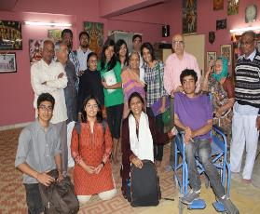
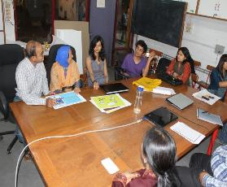
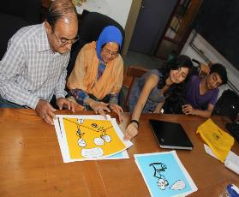
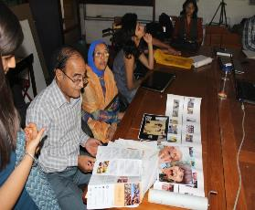
Objective:
To develop body of knowledge for students of architecture to learn universal design.

Slide 48
Teaching Fellowship – 2013-14
?
Design studio
Semester - 1
Semester - 2
Six month
Six month
One year

Slide 49
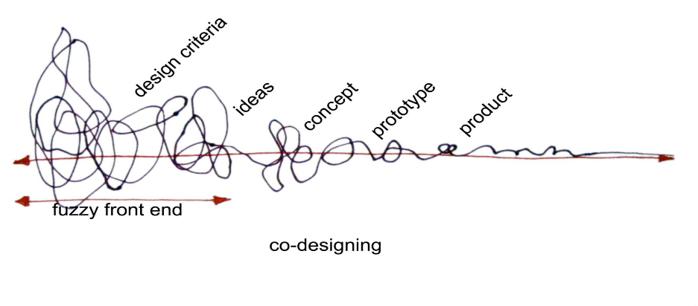
Regular architecture design process
1. Problem Identification/ Data Collection/ Standards and Context
3. Design idea
5. Final Design
2. Analysis
(design criteria)
4. Design
Development
Design Development (cyclic process)
Final Design
Post Occupancy Studies after Implementation
DESIGN PROCESS
Adapted from the Source: Elizabeth B., N. Sanders & Pieter Jan Stappers, S. Co Design, Taylor & Francis, March 2008.

Slide 50
Universal design by user-centered approach
User
as subject
User
as partner
User feed -back
1. Problem Identification/ Data Collection/ Standards and Context
3. Design idea
5. Final Design
2. Analysis
(design criteria)
4. Design
Development
Design Development (cyclic process)
Final Design
Post Occupancy Studies after Implementation
USER-CENTERED APPROACH IN DESIGN PROCESS
Adapted from the Source: Elizabeth B., N. Sanders & Pieter Jan Stappers, S. Co Design, Taylor & Francis, March 2008.

Slide 51
STUDIO EXERCISE : Proposed site

Slide 52
UJJAIN DURING HINDU FESTIVALS

Slide 53
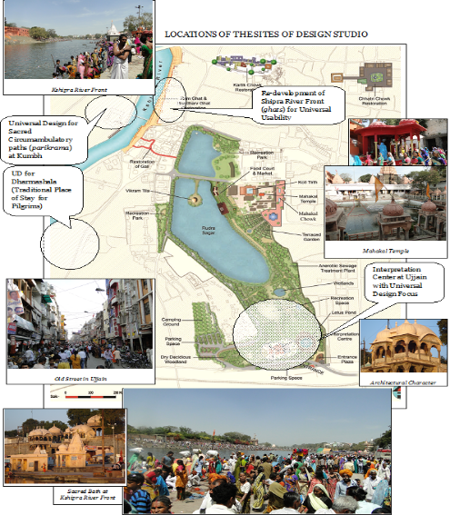
STUDIO EXERCISE :
DESIGNING OF TEMPORARY SHELTERS FOR VISITORS

Slide 54
How user centered approach used in the studio?
USER-CENTERED APPROACH DESIGN STUDIO
Inputs for the design correction
Inputs from
user experts and Ujjain experts during studio
User
as partner
User
as subject
User
Feed
-back
Primary Sources (Field Survey)
Secondary Sources
The Major Techniques that has been used in the Design Studio
Observation of Users’
Existing Literature
Observation of behavioral’ Traces
Existing Case-studies
Interviews of Users’

Slide 55
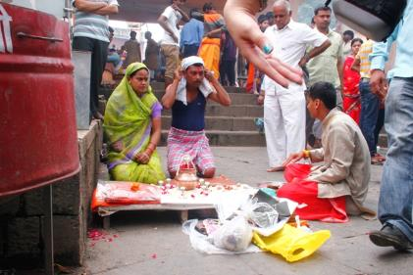
USER AS A SUBJECT 1. OBSERVING ENVIRONMENTAL BEHAVIOR
Who,
Doing what,
With whom,
In what relationship
In what context
And where

Slide 56
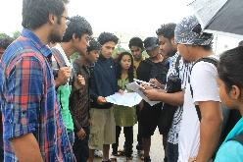
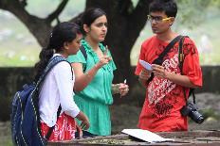
USER AS A SUBJECT 2. USER INTERVIEWS
How it connects to your design
Inquiry
What do you want to know from the users?
Questions
How would you ask the Question?
Answers
Main Issues Identified/
Categories of issues.

Slide 57
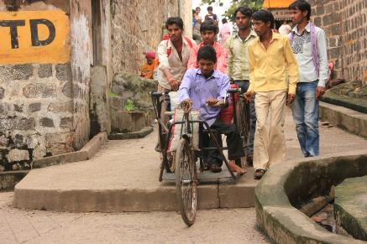
USER INTERVIEWS

Slide 58
USER INTERVIEWS

Slide 59
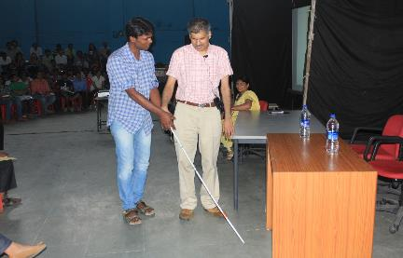
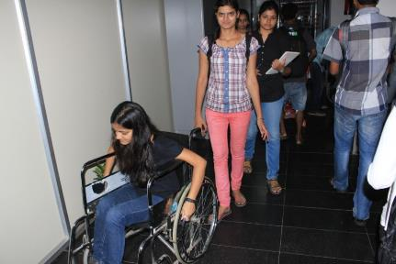
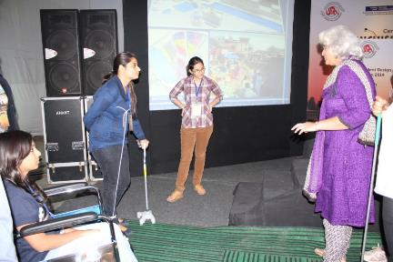
USER AS A PARTNER 1. Simulation exercises to sensitize students to respond to the problem area, users and issues

Slide 60
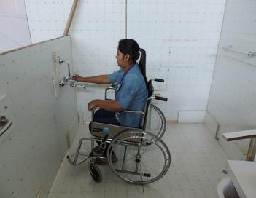
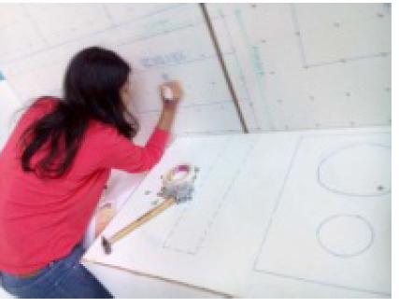
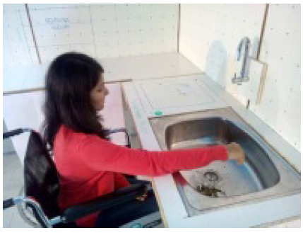
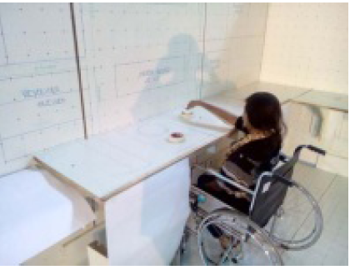
USER AS A PARTNER 2. Full scale model simulation

Slide 61
Assembly of information:
Pre-final design
FIELD SURVEY
USER AS A PARTNER
USER AS A SUBJECT

Slide 62
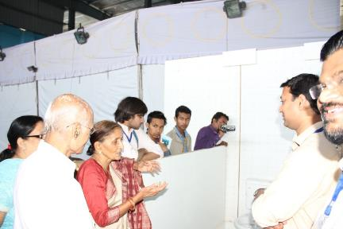
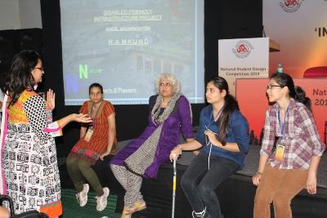
USER FEEDBACK:
Pre-final deign
USER FEEDBACK
Final deign
Final design feedback from the users.

Slide 63
STUDENTS WORK:

Slide 64
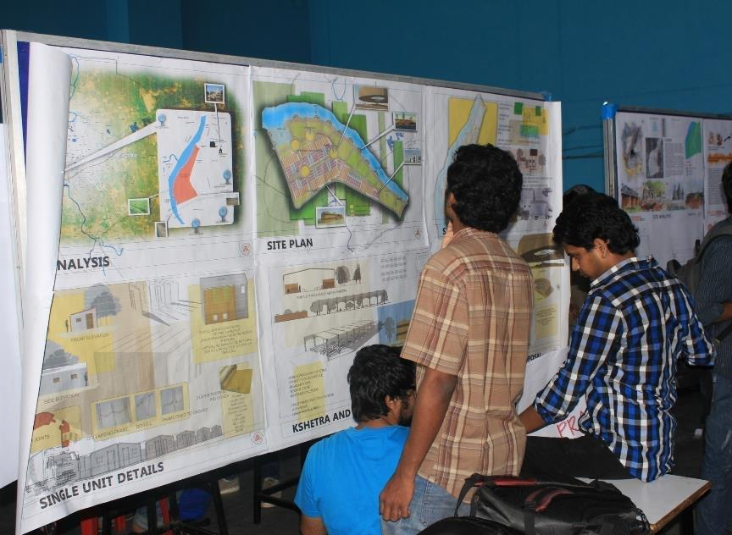
STUDENTS WORK:

Slide 65
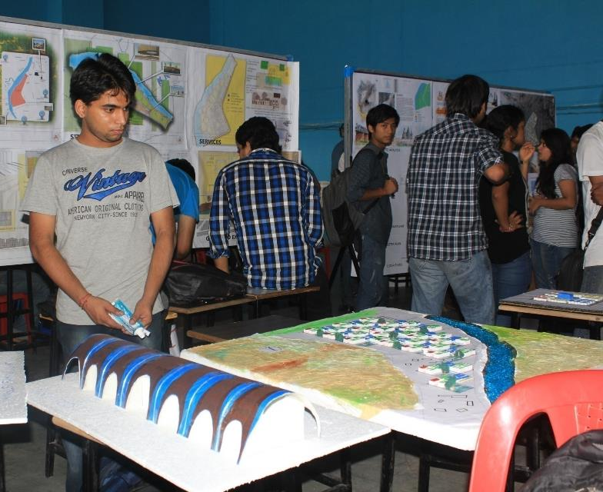
STUDENTS WORK:

Slide 66
Result:
Universal design by user-centered approach
1. Problem Identification/ Data Collection/ Standards and Context
3. Design idea
5. Final Design
2. Analysis
(design criteria)
4. Design
Development
Design Development (cyclic process)
Final Design
Post Occupancy Studies after Implementation
DESIGN PROCESS
Adapted from the Source: Elizabeth B., N. Sanders & Pieter Jan Stappers, S. Co Design, Taylor & Francis, March 2008.

Slide 67
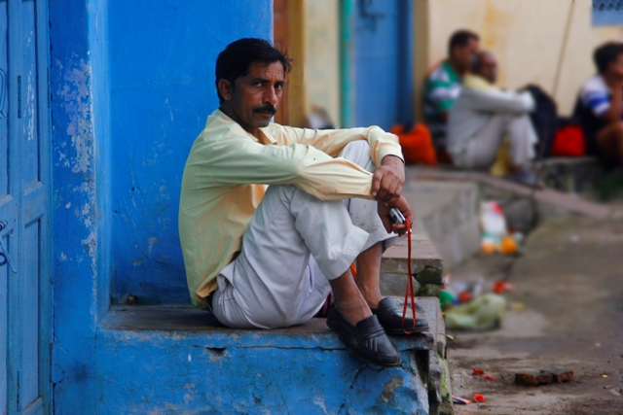
Lessons:
1. People in the community

Slide 68
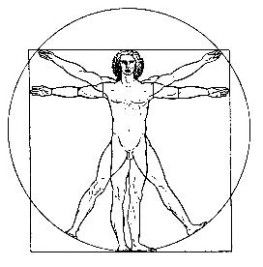
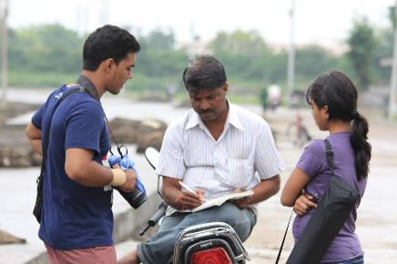
Lessons:
Neufert/architectural standards
2. Design to fit need of people

Slide 69
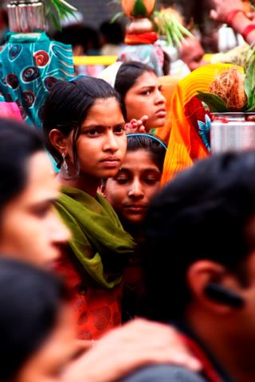
Lessons:
3. Use of user-centered approach to improve lives of all

Slide 70
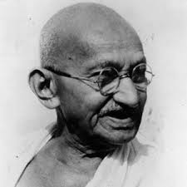
‘Real education consists in drawing the best out of yourself. What better book can there be than the book of humanity?’
(Mahatma Gandhi)

Slide 71
Ms. Alex MacLaren
Summary presented by Benjamin Clavan
Full report available at BerkeleyPrize.org

Slide 72
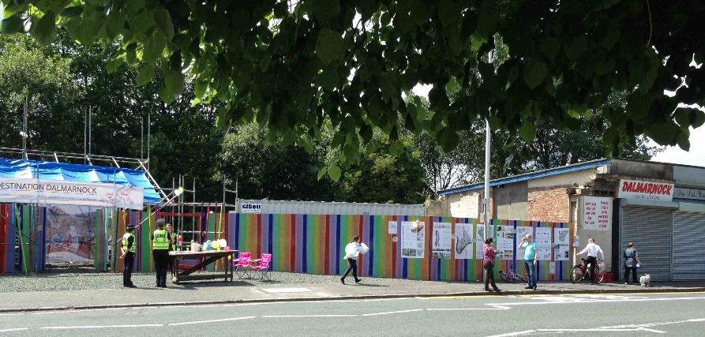

Slide 73
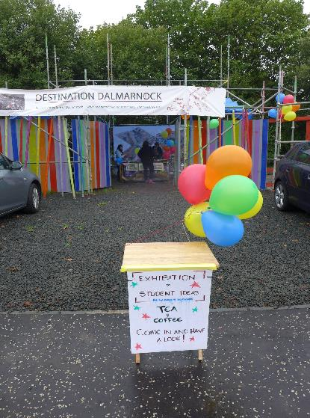

Slide 74
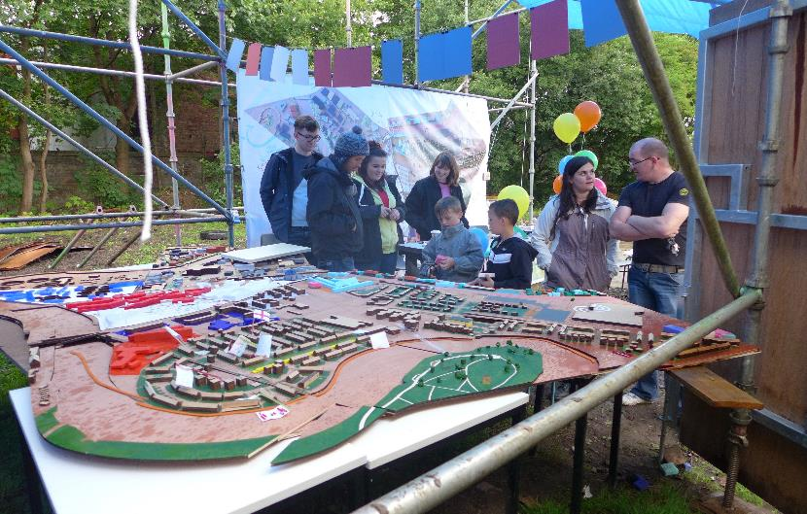

Slide 75
Mr. Josh Safdie
Summary presented by Benjamin Clavan
Full report available at BerkeleyPrize.org

Slide 76
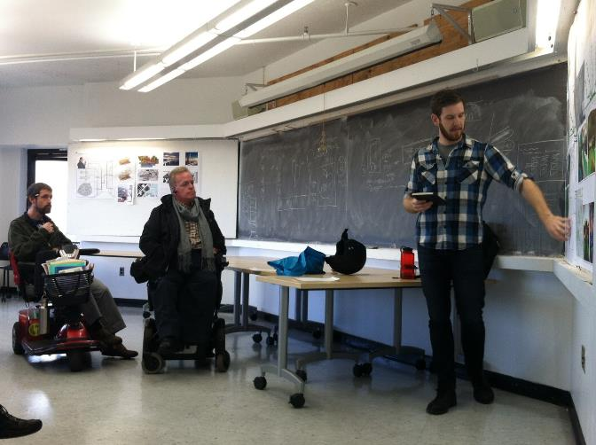

Slide 77
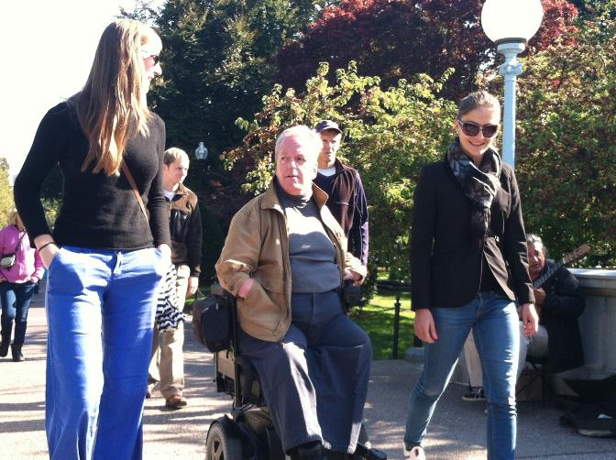

Slide 78
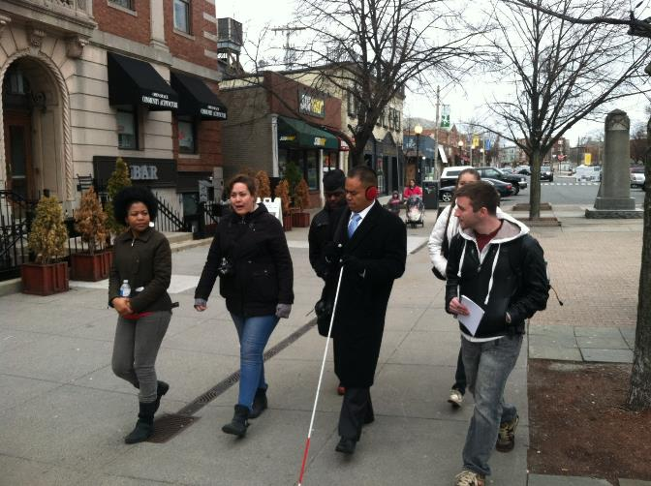

Slide 79
Mr. Faiq Mari
Summary presented by the author
Full paper available in the Proceedings

Slide 80
Background
PALESTINE
Notes:
I come from Palestine, a country in the middle east (right between Egypt and Jordan). It is a presumably holy site for Abrahamic religions (Judaism, Christianity, and Islam) and is often referred to as The Holy Land.

Slide 81
Palestine faces ongoing ethnic cleansing
Notes:
Palestine and its people have been living an ongoing ethnic cleansing process ever since the late 19th century. The green areas you see above are Palestinian controlled lands, while the yellow are the lands confiscated by Zionists.

Slide 82
Notes:
On the ground, this translates to vicious wars and crimes against humanity; which have taken a very heavy toll on Palestinians.

Slide 83
ca. 1989, Jerusalem, Palestine — Sabrina, a 12-year-old amputee wounded by a bullet during the Intifada, waits for her physical therapist in Makassed Hospital in Jerusalem. — Image by Ricki Rosen/CORBIS SABA
Notes:
In the latest Israeli offense against Gaza in the summer of 2014:
2,000+ killed, 10,000+ injured. 30%+ will suffer from physical disability. In general, the majority of the population in Gaza now suffers psychological problems.

Slide 84
Notes:
I have spared you the graphic images.

Slide 85
How could architectural education help alleviate such conditions and bring justice to people?
Notes:
In light of such a reality one faces the question: How could architectural education help alleviate these conditions and bring justice to people?
First and foremost is the need to fully engage with society and institute Universal Design as a fundamental concept in architectural education

Slide 86
GOAL: Lead the Architecture Dept. to adopt Universal Design as a steering principle.
Notes:
Last year, when I was appointed Teaching assistant my goal was to lead the architecture department to adopt Universal Design as a steering principle.

Slide 87
Approach
Incremental Growth:
In introducing the concept to the Faculty and Administration.
In teaching.
Notes:
In this endeavor, my approach could be summarized in the concept of incremental growth (or gradualness).
Incremental growth both in introducing the concept to the department administration, and to the students.

Slide 88
1. Introducing the concept to the department:
Discuss plan with fellow teachers.
Start with one course only.
Try to achieve good results.
Convince other faculty based on results.

Slide 89
2. teaching:
Ice-breaking discussions and sketch problem
Talks by user/experts
Introductory readings
User/experts involvement and Design applications

Slide 90
Ice-breaking discussion

Slide 91
User/expert session

Slide 92
First Semester

Slide 93
Notes:
This is a project were students concentrated on the acoustical qualities of the space, to deliver the feeling of the “sublime” to persons with sight disabilities.

Slide 94
Notes:
This is a senior house, designed to provide maximum comfort and ease of access. Emphasis was also placed such aspects as smell, sound, light, etc.

Slide 95
Visit to SPA Bhopal, India
Special representative to the National Student Design Competition competition held by School of Planning and Architecture, Bhopal.
Notes:
After the first semester I traveled to India, as a special representative of the Berkeley Prize at the National Student Design Competition held by the School of Planning and Architecture at Bhopal. The competition focused on Universal Design in the Indian context.

Slide 97
Life-sized teaching model
Notes:
This is one particularly interesting tool; a life sized model for young architecture students to experiment with.

Slide 98
Second Semester
Notes:
Now to the second semester.

Slide 99
Approach UD as a wider concept of social inclusion.
Involve more user groups in the design process.
Notes:
I approached UD as a wider concept of inclusion, and involved more user groups in the design process. The project was an inclusive public library, where each team of students focused on the matter from a different perspective.

Slide 100
User/expert session

Slide 101
Student Work
Notes:
This is a library that links two busy streets via its open corridor, and makes it possible for people with disabilities to go form one to the other. It also focuses on inclusion of different age groups in the activities of the library, such as the elderly.

Slide 102
Year Results
Notes:
After these two semesters we arrived at those results

Slide 103
Students showed:
Conviction and interest in UD.
Desire to pursue UD in future courses.
Minor frustration with course outcomes.

Slide 104
Faculty showed:
Increased interest in UD.
More openness towards future application.
Varying enthusiasm.

Slide 105
Administration responded:
Head of department decided to adopt UD in the new curriculum currently being formulated.

Slide 106
Challenges Faced
Bureaucratic hindrances
Difficulty in organization and communication with fellow teachers
Slow/limited adoption by fellow teachers
Thus, limited application of ideas sought
Notes:
It is also important to note the challenges faced:

Slide 107
Lessons Learned
UD has the potential to engage students and faculty.
Gradual application proved to be a successful approach.
Focus more on the concept of UD than on wording. (Pragmatism)
Notes:
And by the last point I mean to find a way to get the concept across to faculty who might otherwise react negatively to this new terminology.

Slide 108
Long-term Proposals
Workshops with faculty to study and develop UD pedagogy suitable to context.
Maintain specific UD-related goals and objectives at each course throughout the curriculum.
Continuously check and develop teaching approach and techniques with faculty and students.

Slide 110
Closing words …
Notes:
After these two semesters we arrived at those results

Slide 111
I hope that this endeavor proves successful on the long term, and a Universal Design curriculum is fully enacted and implemented in Palestine.

Slide 112
At the end, a war can destroy universally designed buildings or adapted roads and sidewalks. Yet, a war cannot unteach designers their awareness and respect for all people they serve.

Slide 114
Thank You!
Notes:
After these two semesters we arrived at those results

Slide 115
PRELIMINARY CONCLUSIONS FROM THE BERKELEY PRIZE TEACHING FELLOWSHIPS
The emphasis must be on place, not studio
User/experts must become an integral part of
the learning environment;
Different standards must be adopted for course outcomes; and
Social scientists must be (re-)integrated into
the design process.

Slide 116
TEACHING EMPATHY

Slide 119
www.BerkeleyPrize.org

Slide 120
Copyright © The BERKELEY PRIZE 2014

