Slide 1
2015 UIA-PHG+GUPHA: Annual Conference, Dalian,
China: Health for All: Cultural, Populational, Operational, and Technological Influences
DESIGNING FOR HEALTH:
Teaching the Social Art of Architecture
BENJAMIN CLAVAN, Ph.D., A.I.A.
Coordinator, International Berkeley Undergraduate Prize
for Architectural Design Excellence
Benjamic@earthlink.net; info@BerkeleyPrize.org

Slide 2
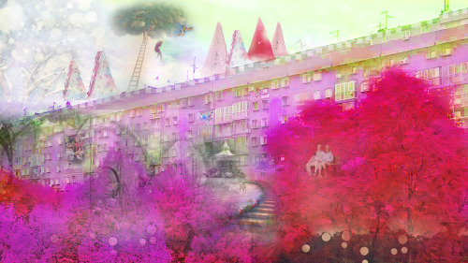
“I have made a decision to create a fairy tale for old people wanting them to experience - one more time - the gratuitous joy and innocence only a child could feel. A location for the fairy tale would be where all fairy tales take place - in a land far, far away, outside the framework of reality - above their apartment…”
(Student: Milica Stojanovic, University of Belgrade)

Slide 3
WHY WE ALL SHOULD BE INTERESTED IN PEOPLE-CENTERED ARCHITECTURE
PEOPLE-CENTERED ARCHITECTURE WORKS IN TWO WAYS TO SUPPORT GENERAL HEALTH
PEOPLE-CENTERED ARCHITECTURE SHIFTS DESIGNERS’ FOCUS
PEOPLE-CENTERED ARCHITECTURE PROVIDES THE HEALTHCARE INDUSTRY WITH A MODEL FOR PROBLEM-SOLVING

Slide 4

International Berkeley Undergraduate
Prize for Architectural Design Excellence
PURPOSE:
To promote the investigation and teaching of the Social Art of Architecture… at the heart of which is the shift from object-centered to people-centered design.

Slide 5
FOUNDED BY:
RAYMOND LIFCHEZ
Professor of Architecture and City & Regional Planning
University of California, Berkeley
U.S.A.
DEDICATED TO HIS WIFE:
Judith Lee Stronach
May 25, 1943 - November 29, 2002
Poet, Journalist, Teacher, Philanthropist

Slide 6
COORDINATOR AND WEBSITE EDITOR:
Benjamin Clavan, Ph.D., A.I.A.
TEAM MEMBERS:
Thea Chroman, Administrator
Jessie Canon, Internet Technology
BERKELEY PRIZE COMMITTEE:
63 Current Members
Educators, Design Professionals, Allied Professionals, Social Scientists

Slide 7


Slide 8
YEARLY THEMES
THE ARCHITECT MEETS THE NURSING HOME
VALUING THE SACRED
SUSTAINABLE ARCHITECTURE/TRADITIONAL WISDOM
ARCHITECTS CONFRONT POVERTY
2014
THE ARCHITECT AND THE HEALTHFUL
ENVIRONMENT

Slide 9
STUDENT COMPETITIONS
Essay Prize: 1997 - 2015
Travel Fellowships: 2004 - 2015
Architectural Design: 2008 - 2012
Number of Student Participants: 1870
Countries Represented: 62
Prizes Awarded: 116 – Students; 8 - Faculty

Slide 10
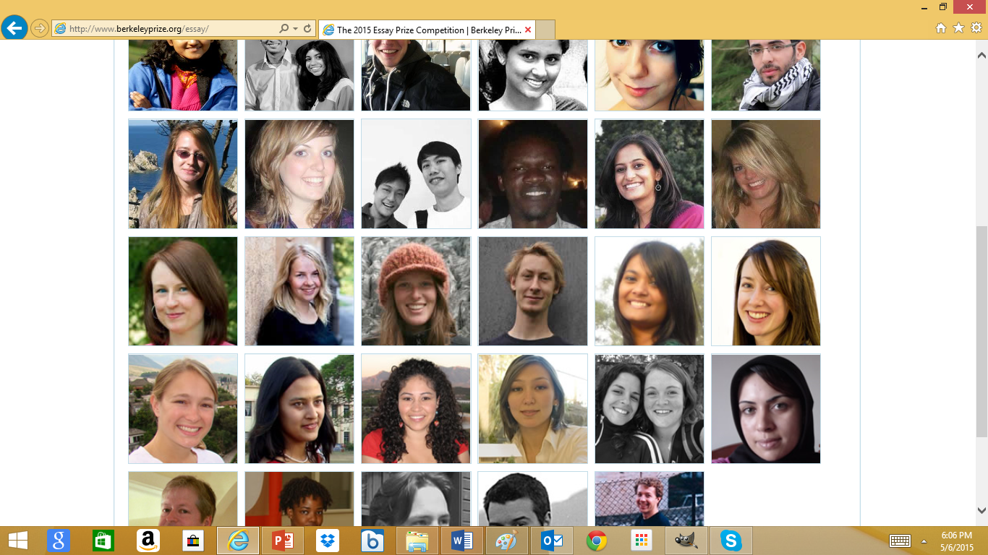

Slide 11
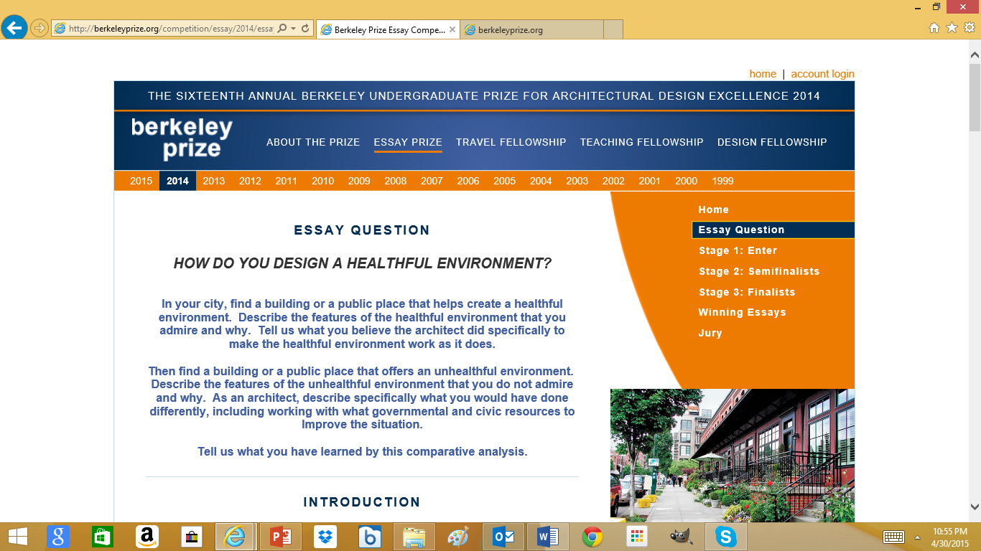

Slide 12
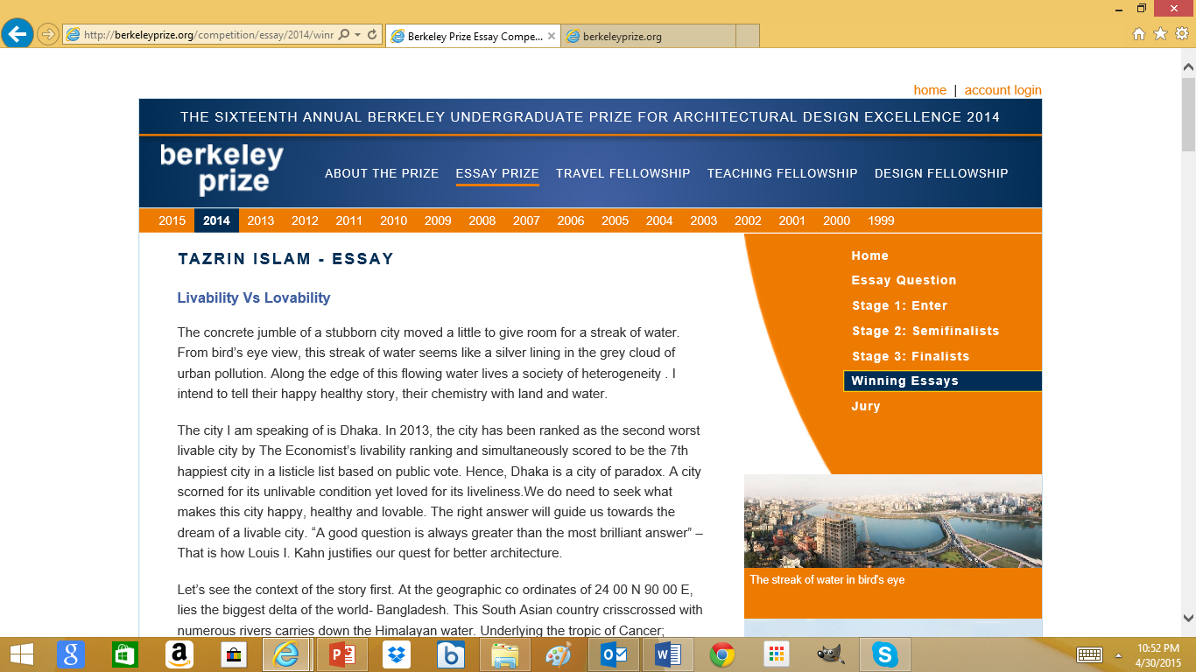

Slide 13
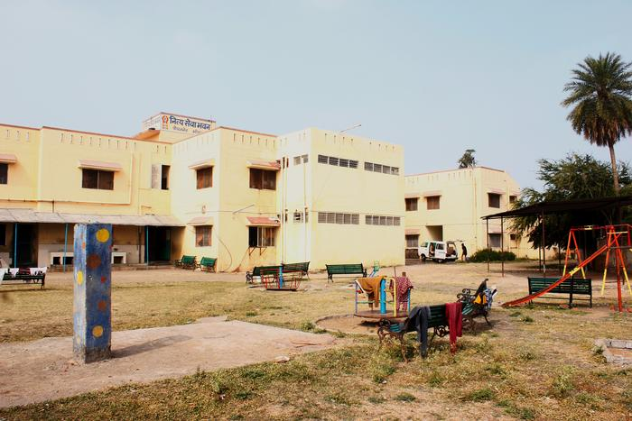
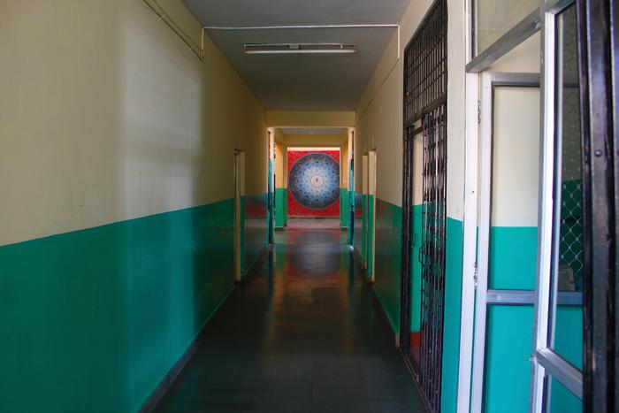
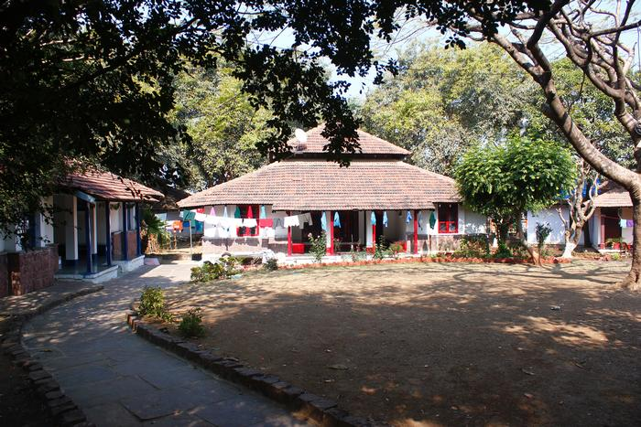
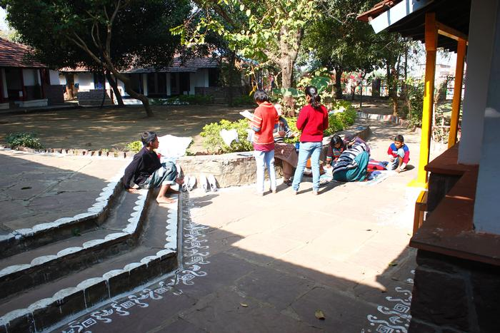
From the 2014 PRIZE Second Place Winners, “Spaces to Grow in –
A Comparative Study of Two Orphanages,” by Nipun Prabhakar and
Gupta Sukruti, School of Planning and Architecture (SPA), Bhopal, India.

Slide 14
FACULTY COMPETITIONS
Teaching Fellowships: 2013 - 2014
Coordinated by:
MS. ELAINE OSTROFF, HONORARY AIA
Co-founder of Adaptive Environments (now, Institute for Human Centered Design – IHCD), Boston, Massachusetts, U.S.A.; Creator of the term “User/expert”

Slide 15
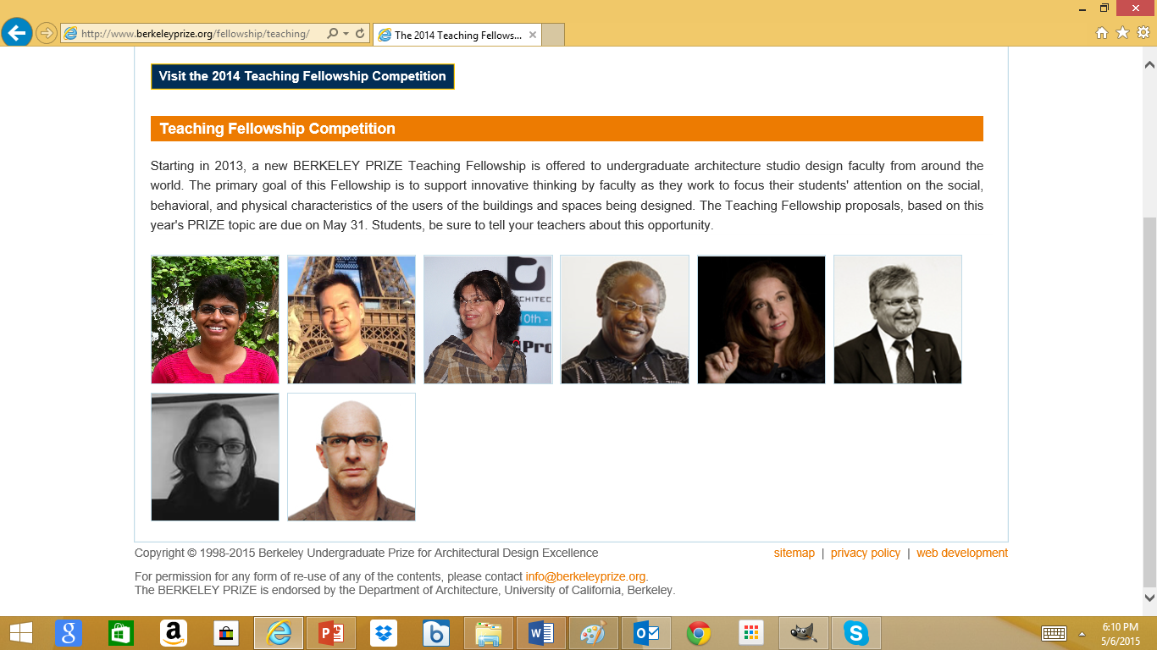
Ms. Gauri Bharat, Ph.D. Candidate, M. Arch., Assistant Professor of Architecture, CEPT University, Ahmedabad, India
Ms. Ružica Božović-Stamenović, Ph.D. Associate Professor, Faculty of Architecture, University of Belgrade, Serbia (first semester); Visiting Senior Fellow, Department of Architecture, National University of Singapore (second semester)
.
Mr. Joseph Francis Wong, Ed.D., M. Arch. Assistant Professor, Department of Architecture and Civil Engineering, the City University of Hong Kong

Slide 16
AREAS OF AGREEMENT
Healthful architecture encompasses both physical
and mental health.
Healthful architecture is a reiterative process that must start and end with the input and acceptance
of the user/experts.
Healthful architecture requires students to be
sensitized to the complexity of issues that must be
addressed for a successful design.

Slide 17
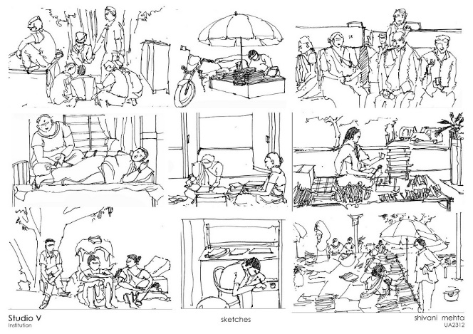
Observing and sketching people in public places.
(Student: Shivani Mehta, CEPT University, Ahmedabad)

Slide 18
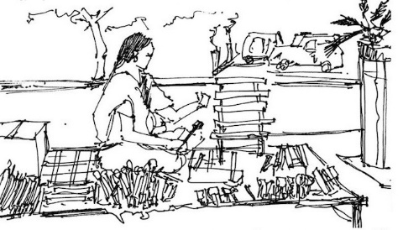

Slide 19
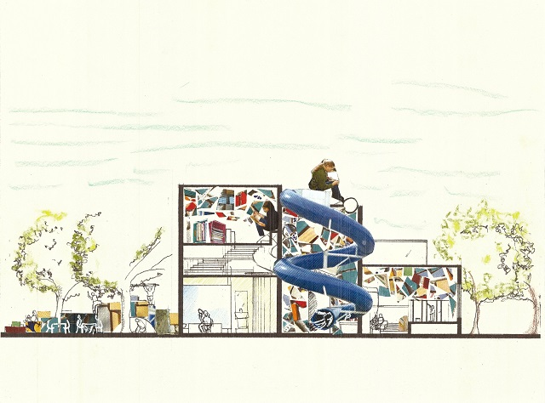
Collage, imagining the library as a public place.
(Student: Surabhi Khanderia, CEPT University, Ahmedabad)

Slide 20
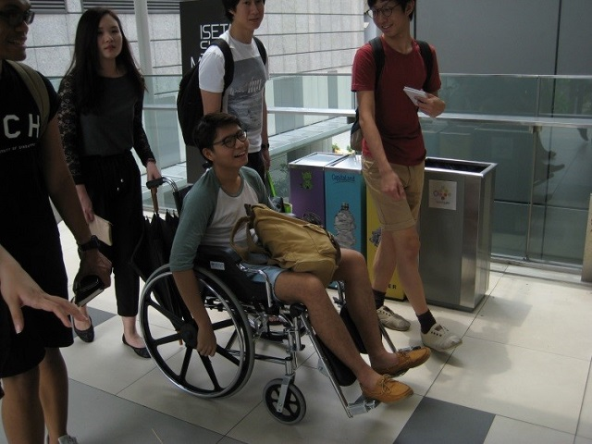
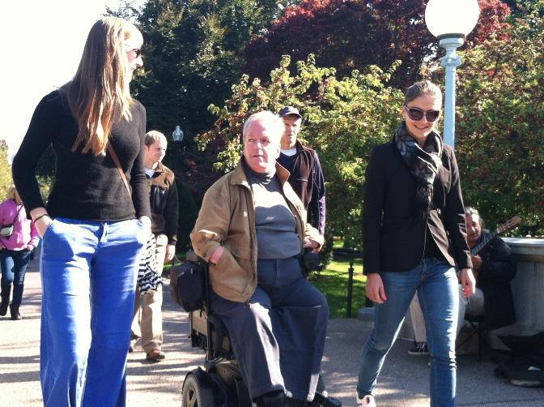
Introducing students to the lives of the “other.”
(Students from the National University of Singapore, and the
Edinburgh School of Planning and Architecture - ESALA)

Slide 21
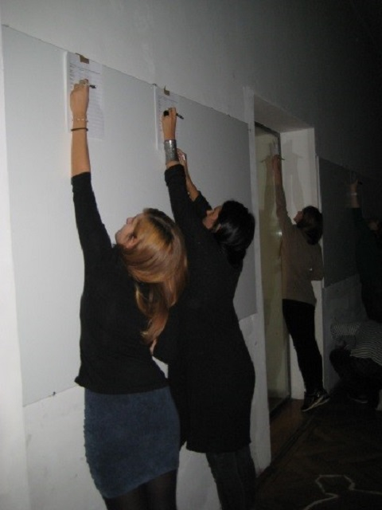
(Students from the University of Belgrade)

Slide 22
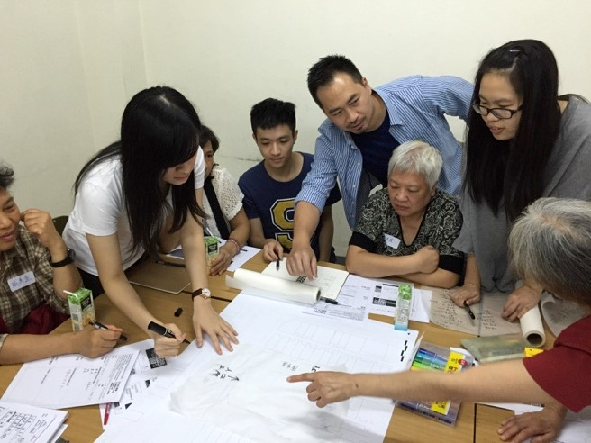
The user/experts, the elderly who will inhabit the project, are
integrated into the design process at the City University of Hong Kong.

Slide 23
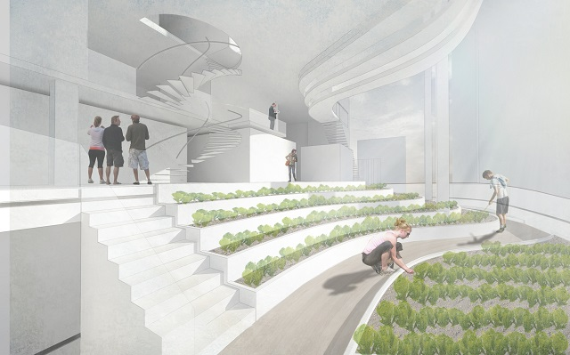
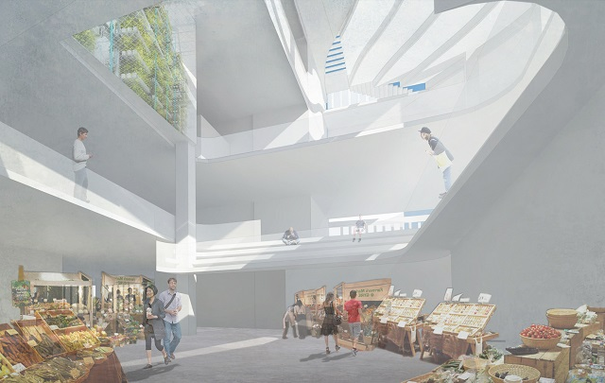
Renderings for a “Healthful Vertical Village.”
(Student: Matthew Fong, City University of Hong Kong)

Slide 24
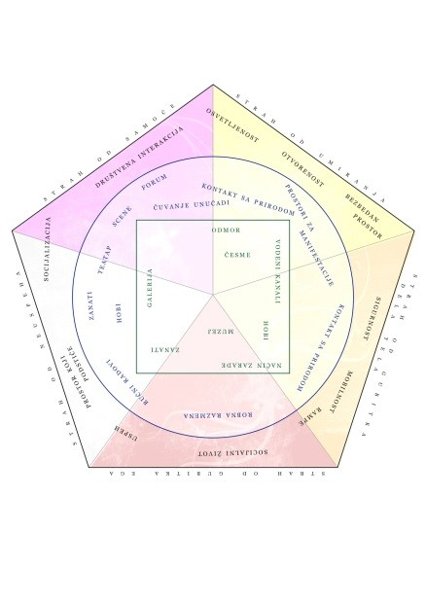
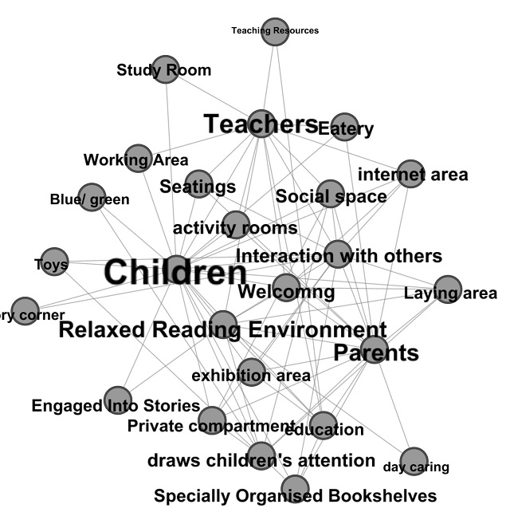
Diagram of influences on users (in Serbian) showing students’ awareness of the complexity of issues. (Student: Milos Mitrovic, University of Belgrade)
The Gephi software graph
of the combined students’ mind map. Bolder, larger entries show “closeness” among concepts. (City University of Hong Kong)

Slide 25
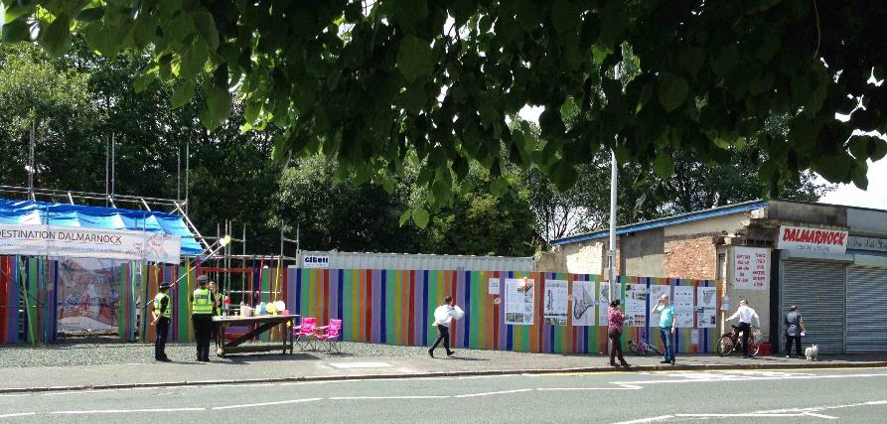
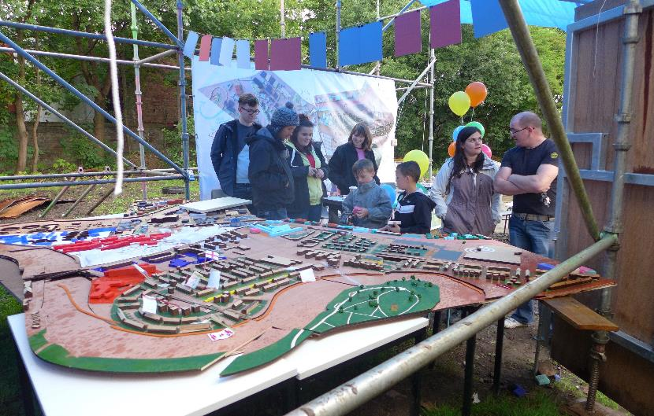
Edinburgh School of Architecture and Landscape Architecture (ESALA) students set-up shop in the community to start a dialogue with residents about what they want for a new community development.

Slide 26
A BASIS FOR CHANGE
INSIDE THE ACADEMY, this new approach questions the accepted dogma of subjectivity and neutrality in traditional teaching and requires much more willingness on everyone’s
part to listen and respond to user input.

Slide 27
A BASIS FOR CHANGE
OUTSIDE THE ACADEMY, this new approach requires a willingness to engage with the community in ways much different than traditionally accepted and much more difficult to organize and control.

Slide 28
THE CHANGE
1. The emphasis must be on place, not the design studio.
        User/experts must become an integral part
        of the learning and design environment.
3. Different standards must be adopted for evaluating successful outcomes.
4. Social scientists must be full integrated into the design process.

Slide 29
5.
THE IDEA OF EMPATHY MUST
BE FOREMOST IN THE MINDS
OF EVERYONE INVOLVED IN CREATING THE BUILT WORLD, INCLUDING HEALTHCARE SETTINGS.

Slide 30
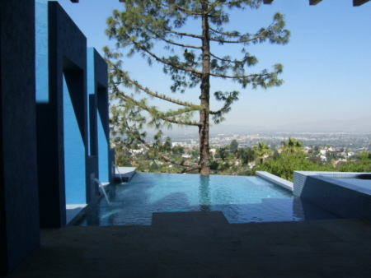
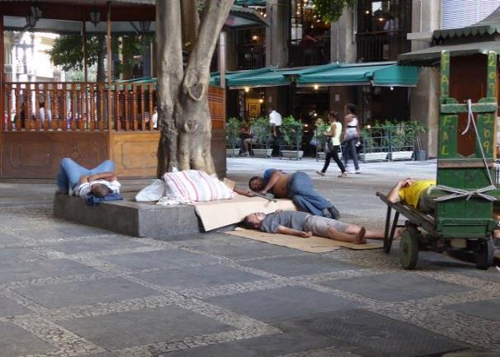
Single-Family Residence,
Hollywood Hills, CA, U.S.A.:
Benjamin Clavan, Architect, AIA
Homeless encampment, Central
Business District, Sao Paulo, Brazil

Slide 31
BERKELEY PRIZE 2016
15 September, 2015
www.BerkeleyPrize.org

